Slide 1
A nationwide system for knowledge-based management within healthcare
Notes:
A national board for knowledge-based management in Swedish healthcare: a joint structure for quality and safety in all 21 regions of Sweden.

Slide 2
A short video and introduction to the Swedish way of knowledge-based management
Notes:
Länken I rubriken länkar till webbsidan där filmen finns: https://kunskapsstyrningvard.se/kunskapsstyrningvard/omkunskapsstyrning/nationalsystemforknowledgedrivenmanagementwithinswedishhealthcare.56857.html

Slide 3
Sweden
Area: 528.447 km2, third largest country in Western Europe
Population: Almost 10.4 million
Form of government: constitutional monarchy, parliamentary democracy
Life expectancy: women 84.3 years, men 80.6 years
Cost for healthcare: Approximately 11 % of gross domestic product

Slide 4
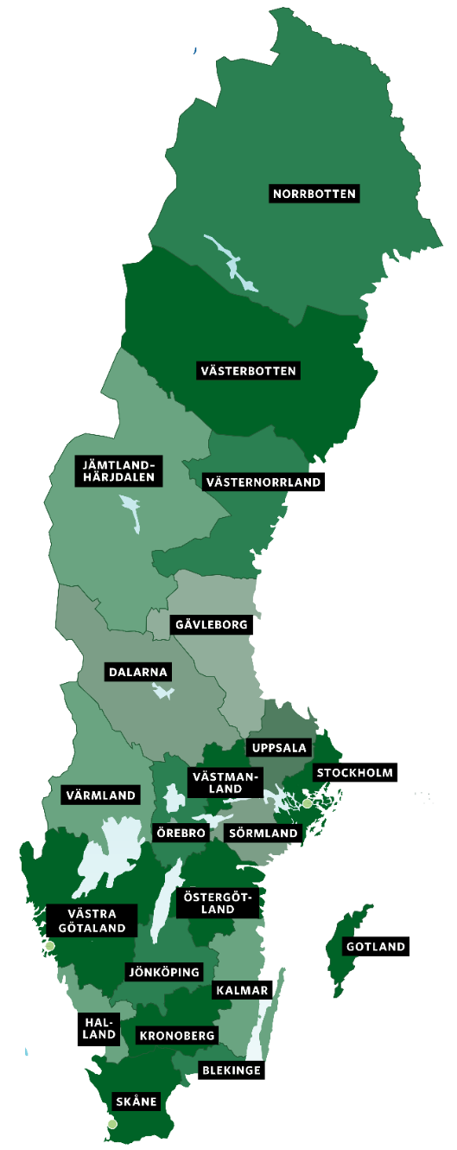
Decentralised healthcare
Public funded system, shared responsibility between national government and local authorities
National level Legislation, monitoring and education/training
Regions (21) Healthcare, but also regional development and support to cultural activities and public transport
Municipalities (290) Social services; care of elderly and disabled people, schools and school health care, spatial planning and building, health and environmental protection, rescue services, order and security etcetera.
Larger healthcare regions (6) Geographic partnership, consolidate specialised care within the region and other collaborations.

Slide 5
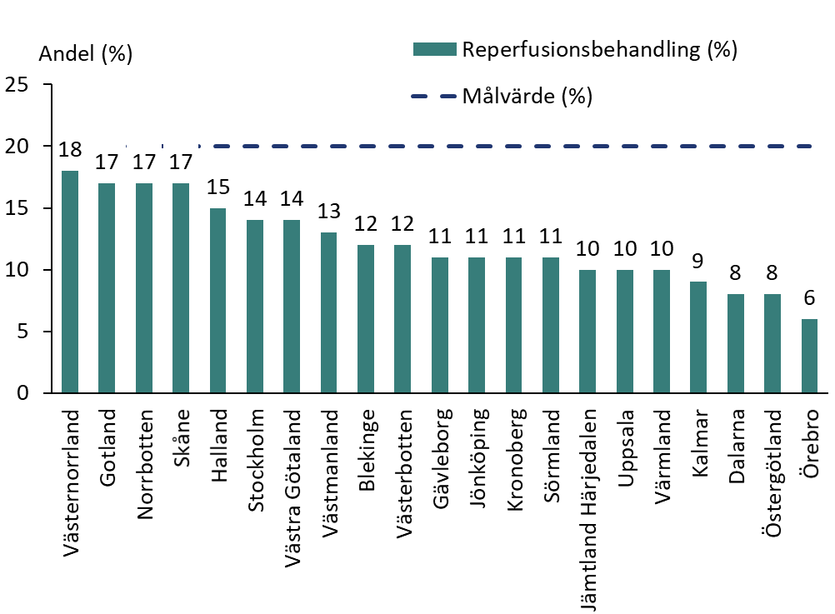
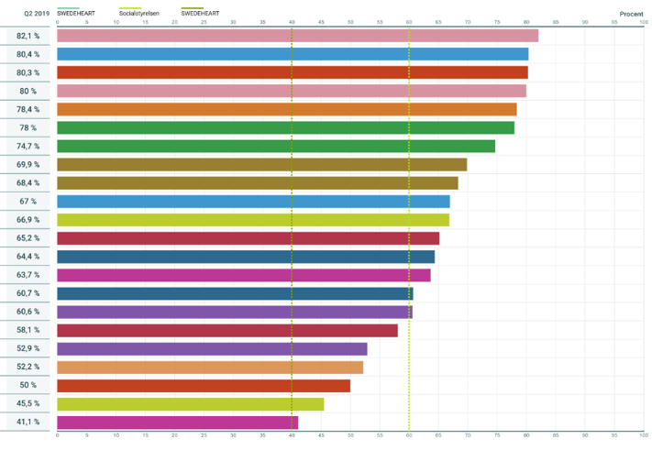
Health care differs between the 21 regions
Reimbursement treatment, stroke
Goal completion for LDL-cholesterol after myocardial infarction
41-82 %
6-18 %
Källa: Vården i siffror, data från 2018 respektive 2019-2020
Notes:
Bilden visar hur det kan skilja sig mellan regionerna hur vård bedrivs. Målet är att få en jämlik vård över hela landet baserat på bästa tillgängliga kunskap.

Slide 6
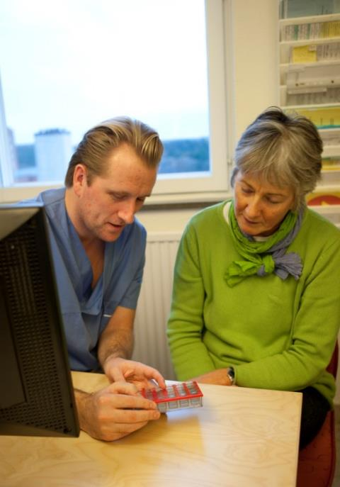
Knowledge-based management in practice
The patient as co-creator
We use the best available knowledge
The meeting is followed up and analysed
New knowledge is put into practice quickly
Identify areas of improvement with the patient
Support patients and care givers to work knowledge-based.
Notes:
Knowledge-based - Healthcare should be based on the best available knowledge, originating both from science and tried and tested experience.
Safe - Healthcare should be safe. Risk prevention of injuries is essential. Operations should be characterised by legal certainty.
Individually adapted - Healthcare should be carried out with respect for the individual’s specific needs, expectations and integrity. The individual should be given the opportunity to participate.
Equal - Healthcare should be provided and distributed on equal terms for everyone.
Accessible - Healthcare should be accessible and provided within a reasonable time. Waiting times should not be unreasonably long.
Efficient - Optimal use of resources can ensure that the best possible healthcare can be offered to the entire population.
Develop, disseminating and using the best knowledge
The goal – the best knowledge shall be available and used in every patient meeting
This is included:
Knowledge support (e.g. national guidelines/scientific publication)
Support for follow-up and analysis
Support for operational development
Support for management and leaders
These contribute to the development of a learning system

Slide 7
A learning system
Knowledge
support
Cohesive system
for knowledge-based
management
Support for
follow-up,
open comparison
and analysis
Leadership and support for development
Notes:
A cohesive system for knowledge-based management: a learning system
The focus of the system is to create a cohesive structure for knowledge-based management, and to support a learning-based approach in Swedish healthcare.

Slide 8
Notes:
Source reference for the image: The image was developed in 2013 at SALAR, and is based on the Microsystem model
Nelson EC, Batalden PB, Huber TP, Mohr, JJ, Godfrey MM, Headrick, LA, Wasson, JH: Microsystems in Health Care: Part 1. The Joint Commission Journal on Quality Improvement. Volume 28 (9): 472-493, 2002. Article in Swedish

Slide 9
26 national program groups and 7 national collaboration groups – hosted by 6 health care regions and SALAR
Norra sjukvårdsregionen
Endokrina sjukdomar
Levnadsvanor
Cancersjukdomar (vilande, SKR)
Sjukvårdsregion Stockholm/Gotland
Sjukvårdsregion mellansverige
Hud- och könssjukdomar
Infektionssjukdomar
Medicinsk diagnostik
Reumatiska sjukdomar
Sällsynta sjukdomar
Ögonsjukdomar
Akut vård
Hjärt- och kärlsjukdomar
Äldres hälsa och palliativ vård
Öron-,näsa-, halssjukdomar
SALAR
Västra sjukvårdsregionen
Cancersjukdomar (vilande)
NSG Forskning och life science
NSG Läkemedel och medicinteknik
NSG Metoder för kunskapsstöd
NSG Data och analys
NSG Patientsäkerhet
NSG Strukturerad vårdinformation
NSG Stöd för utveckling
Lung- och allergisjukdomar
Mag- och tarmsjukdomar
Psykisk hälsa
Rörelseorganens sjukdomar
Kirurgi och plastikkirurgi
Sjukvårdsregion Sydöstra
Södra sjukvårdsregionen
Barns och ungdomars hälsa
Kvinnosjukdomar och förlossning
Perioperativ vård, intensivvård och transplantation
Rehabilitering, habilitering och försäkringsmedicin
Nervsystemets sjukdomar
Njur- och urinvägssjukdomar
Nationellt Primärvårdsråd
Tandvård
Notes:
OBS! Visa denna bild mer som en översikt, som en illustration över att det nationella ansvaret är utspritt över hela landet. Visa gärna den egna sjukvårdsregionen för värdskapet och berätta på engelska namnen på NPO.

Slide 10
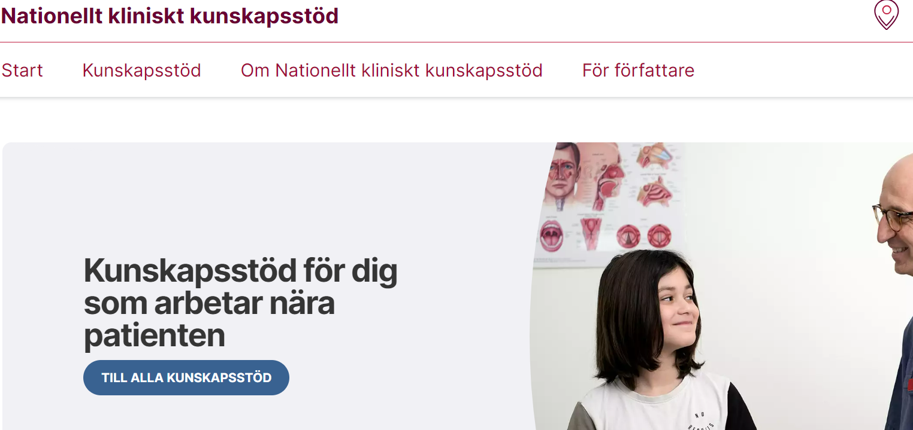
Nationelltklinisktkunskapsstod.se holds care recommendations, processes and programmes
Notes:
Nationellt kliniskt kunskapsstöd är platsen för gemensamma kunskapsstöd. Nationelltklinisktkunskapsstod.se

Slide 11
We count our success in lives and equal health!
We make each other successful!
kunskapsstyrningvard.se

